Slide 1


KLOEs – SMT Briefing
Well Led 20 March 2019

Slide 2

Are they Well Led?
The leadership, management and governance of the organisation make sure it's providing high-quality care that's based around your individual needs, that it encourages learning and innovation, and that it promotes an open and fair culture.
Notes:
UCLAN meeting held

Slide 3

Outstanding!!
49 Hospices inspected by the CQC are Outstanding!
17 are CYP Hospices
1 has been inspected under the new framework
Even fewer get Outstanding for being Well Led

Slide 4
Guidance and Framework
Guidance Framework available for all services covered by the CQC
Children's and Young People Hospice Framework
Its NEW!!

Slide 5
Key Line of Enquiry
Safe
Well Led
Re-sponsive
Caring
Effective

Slide 6
Guidance and Framework – the fundamentals
8 key questions
W1. Is there the leadership capacity and capability to deliver high-quality, sustainable care?
W2. Is there a clear vision and credible strategy to deliver high-quality sustainable care to people who use services, and robust plans to deliver?
W3. Is there a culture of high-quality, sustainable care?
W4. Are there clear responsibilities, roles and systems of accountability to support good governance and management?
W5. Are there clear and effective processes for managing risks, issues and performance?
W6. Is appropriate and accurate information being effectively processed, challenged and acted upon?
W7 Are the people who use services, the public, staff and external partners engaged and involved to support high-quality sustainable services?
W8. Is there transparency and openness with all stakeholders about performance?

Slide 7
Key Line of Enquiry
Safe
Well Led
Re-sponsive
Caring
Effective
Well Led
Key areas of concern:
Clear vision and strategy
  Person centred care promotion
  Empowering
Clear governance framework with accountabilities
All stakeholders engaged and involved
Continuous improvement
Working in partnership with other agencies

Slide 8



Key Line of Enquiry
Safe
Well Led
Re-sponsive
Caring
Effective
Well Led – outstanding Hospices
Notes:
5 items each

Slide 9
Key Line of Enquiry
Safe
Well Led
Re-sponsive
Caring
Effective
Well Led – outstanding Hospices
It provided a range of opportunities for people who used the service, their relatives and people from the wider community to comment on and influence the quality of service provided.
The Board of Trustees, the Chief Executive and the Registered Manager met regularly
The service worked in partnership with other organisations to ensure they followed best practice and provided a high quality service
They developed new services to meet the needs of the people in and outside their catchment area.
Staff told us they felt well supported and were encouraged to learn and improve their skills and knowledge. - clinical champions
Robust auditing systems in place
You said, we did` board
Notes:
The service was very well-led.
The service promoted a positive and open culture. It provided a range of opportunities for people who used the service, their relatives and people from the wider community to comment on and influence the quality of service provided.
The Board of Trustees, the Chief Executive and the Registered Manager met regularly to discuss the services offered to people and their families and ways to improve and diversify these.
The service worked in partnership with other organisations to ensure they followed best practice and provided a high quality service. They developed new services to meet the needs of the people in and outside their catchment area.
There were robust auditing systems in place to ensure the quality of the service was monitored and actions were in place to constantly drive improvement.
There was a constant effort to improve and people`s voice was actively listened to by staff and the management in the hospice.
Staff told us they felt well supported and were encouraged to learn and improve their skills and knowledge. - clinical champions
here was a `You said, we did` board displayed in the hospice which contained people`s comments.

Slide 10
Key Line of Enquiry
Safe
Well Led
Re-sponsive
Caring
Effective
Well Led – outstanding Hospices
There was an open culture of incident reporting within the service and learning from incidents
The PIR was comprehensive and identified areas for improvement and development.
The hospice had pledged to improve patient safety by signing up to the national NHS 'Sign up to Safety’ campaign
There was also a visual aid for feedback within reception called 'Your token counts'.
A librarian in place
A clear clinical governance structure outlined responsibilities
Notes:
There was an open culture of incident reporting within the service and learning from incidents was key to providing a safe and effective service. Strong emphasis was placed on continuous improvement of the service and best practice.
he PIR was comprehensive and identified areas for improvement and development.
he hospice had pledged to improve patient safety by signing up to the national NHS 'Sign up to Safety’ campaign
The senior management team met regularly with the board of trustees. Quarterly reports were shared with the board which included an overview of complaints and concerns, pressure ulcer management, feedback from 'I want great care', bench marking data and accidents, incidents and near misses. This ensured information was escalated from local level governance meetings and information was shared from top-level governance.
There was also a visual aid for feedback within reception called 'Your token counts'. People could put a token in the clear box which matched their general views. The caption on the box explained that the hospice were continuously trying to improve the patient experience and asked how likely people were to recommend the service to friends and family if they needed similar care or treatment.
A librarian in place
A clear clinical governance structure outlined responsibilities and r

Slide 11

Key Line of Enquiry
Safe
Well Led
Re-sponsive
Caring
Effective
Well Led – outstanding Hospices
Not outstanding for Well led!! But for the other areas.
Missed out on outstanding;
  Not all outcome measures collected by the service were reported on during governance meetings meaning that outcome measures did not always shape and improve services.
  The service did not have effective systems in place to monitor equipment maintenance and expiry on the inpatient unit.
They forgot the basics!

Slide 12



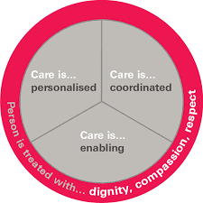
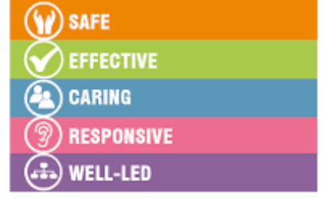


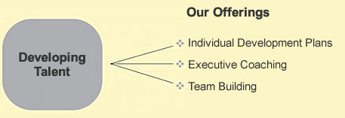
Key Line of Enquiry
Safe
Well Led
Re-sponsive
Caring
Effective
Well Led
Notes:
Staff had a shared vision of continuous improvement and worked within a culture of striving to provide personalised, holistic care that met people's individual needs
The provider had systems in place to gather the views of people, relatives, staff and others involved in the Centre. These views were valued and acted on wherever possible.
Are you learning from outside sources – best practice networking with people outside
Do our leaders have integrity, knowledge and experience if not why not?
Leaders need to understand the CQC standards – fundamental
Everything has to related to person centred care – everything we do needs to be this focus – use this language!

