Slide 1


Syringe Driver Management

Slide 2

Aims of the session
To explain the rationale for the use of syringe drivers in Paediatric Palliative Care
To provide practical guidance for the use of syringe drivers
To explain and guide practitioners to navigate common practical challenges

Slide 3
Learning Objectives
By the end of the session you will be able to:
Understand the policies, procedures and guidelines that govern the application of syringe pumps
Identify when is appropriate to use a syringe pump
Identify the risk and benefits involved with the use of a syringe pump
Gain an awareness of the medications used in syringe pumps
Appreciate and understand the practicalities of setting up a syringe pump and siting a cannula
Trouble shoot any problems with the syringe driver
Competently complete all relevant documentation

Slide 4
NMC Code
Expectations & Accountability:
Must have knowledge and skills for safe and effective practice when working without direct supervision
Recognise and work within the limits of your competence
Keep knowledge and skills up to date throughout your working life
Take part in appropriate learning and practice activities that maintain and develop your competence and performance
Medicines management is up to date
Have an understanding of the medications you are administering in the syringe pump (potentially 2 CDs) including doses and compatibility

Slide 5
Policies & Guidelines
Nationally:
MHRA (Medicine and Healthcare Products Regulatory Agency)
Local:
Health & Safety
Syringe Driver guidelines
Medicines Management Policy
Infection Control
Safe disposal of clinical waste
Risk assessments

Slide 6
What is a Syringe Driver
It is a device to administer a specific amount of medication over an allotted period of time
These medications can be delivered via either the subcutaneous or intravenous (via a central line) route
The syringe drivers in Derian House are calibrated to deliver medications over 24hrs

Slide 7
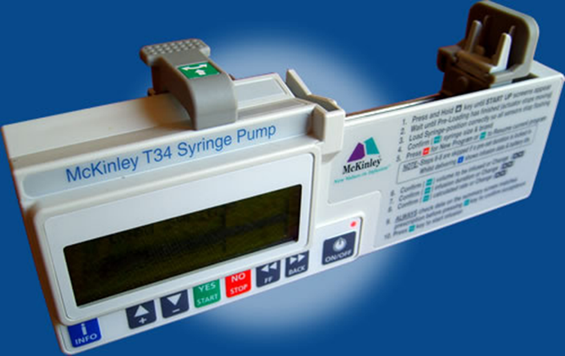
What is a Syringe Driver

Slide 8
Rationale for using a Syringe Driver
There are a variety of reasons why a CYP may require a syringe driver such as:
Malabsorption of medications
Dysphagia (problems swallowing)
Reduced conscious level
Refusal of oral drugs
Inability to maintain therapeutic level of medication
Other routes of administration are inappropriate or not possible
Notes:
There are a variety of reasons why a CYP may require a syringe driver such as:
Malabsorption of medications
- Due to their condition
- Advancing stages of disease
Nausea/vomiting
- Therefore negating the administration of oral medications
Dysphagia (problems swallowing)
- Due to condition
- Due to advancing disease process
Reduced conscious level
- Common in End of Life Care
Refusal of oral drugs
- Oral aversion due to exhaustion, anxiety or hysteria in the final stages
Inability to maintain therapeutic level of medication
- Despite best effort we are unable to reach a level of comfort for the CYP this is caused by increased drug metabolism/advancing stages of disease or drug combination needs refining
Where other routes of administration are inappropriate or impossible
The IM route may be inappropriate due to significant weight loss
IV not available due to inactive line or unable to site a cannula
PO for reasons discussed above
Excessive secretions

Slide 9
Rationale for using a Syringe Driver
A significant number of our CYPs may also require a syringe driver for symptom control related to:
Pain
Nausea/Vomiting
Restlessness/Agitation and Confusion
Convulsions
Excessive secretions

Slide 10
Risks and Benefits
As with any route of medication there are risks and benefits involved
The risks of syringe driver use are as follows:
Reduced mobility of CYP/Manual Handling
Inflammation/infection at cannulation site
Staff competence
Equipment malfunction
Cannula dislodgement
Allergy to dressing

Slide 11
Risks and Benefits
As with any route of medication there are risks and benefits involved
The benefits of syringe driver use are as follows:
Maintain therapeutic level of medication
Ability to administer medications when patient is:
  Asleep
  Unconscious
  Refusing medications
  Has reduced absorption from the gut
  Has difficulty swallowing

Slide 12



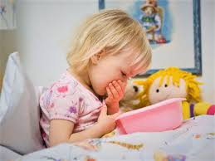
What Drugs are used in a Syringe Driver
Analgesic
Agitation
Consider the 4 A’s
Antiemetic
Antispasmodic

Slide 13

Which drugs and for what
 | Pain | Nausea & Vomiting | Restlessness/Agitation | Noisy breathing
Morphine/ *Diamorphine | X
*Midazolam |  |  | X
Hyoscine Butylbromide |  |  |  | X
*Levomepromazine |  | X | X
Hyoscine Hydrobromide |  |  |  | X
Oxycodone | X
Cyclizine |  | X
Haloperidol |  | X | X
Metoclopramide |  | X
*Used in Derian House

Slide 14
Analgesics
*Diamorphine
Drug of choice due to its solubility
Morphine
Same properties, larger volume in ampoules
Oxycodone
Is a synthetic opioid used as an alternative to morphine

Slide 15
Antiemetic's
*Levomepromazine
Drug of choice due to its effectiveness
Metoclopramide
Should only be used for short term use due to neurological side effects
Cyclizine
Used as a last resort, drug is incompatible with 0.9% NaCl

Slide 16
Agitation
*Midazolam
Drug of choice in Derian House
Levomepromazine
Alternative drug for anxiety & distress
Haloperidol
Not licensed for use in children

Slide 17
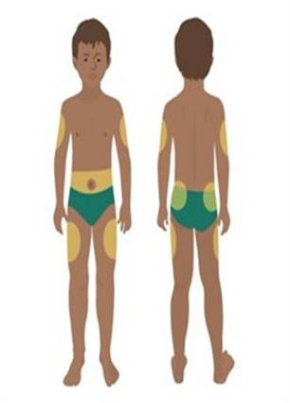
Insertion Sites
Criteria for choosing a site for administration:
Areas where there is a good depth of subcutaneous fat, towards the centre of the body
  Lateral aspects of the upper arms and thighs
  The abdomen
  Anterior chest below the clavicle
  Posterior chest wall between the shoulder blades

Slide 18
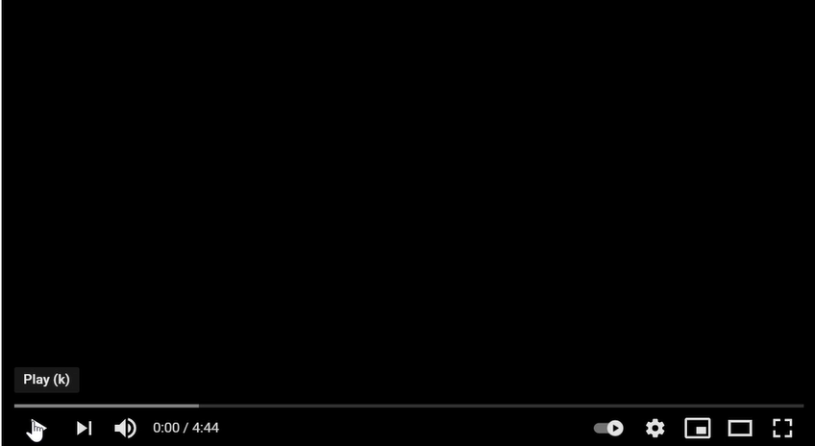
Setting up a Syringe Driver

Slide 19
Setting up a Syringe Driver
Assess the patient (use all tools available – parents, pain tools - FLACC)
Assess suitable insertion site (position, skin integrity, depth of subcutaneous fat)
Assess suitable cannula
Check site (swelling, inflammation, leakage, dislodgement)
Check line/syringe
Check prescription
Check medication (stock check)
Calculate dosage/volume
Collect & set-up equipment
Draw up medication
First set up – prime the line, subsequent same dosage set ups just attach syringe to line
New dose set up - disconnect old line, replace line and prime – connect to cannula

Slide 20
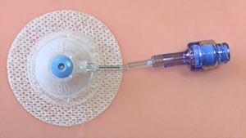
Breakthrough Bolus Method
Given via a separate Saflo, ideally in a separate limb.
Use the short length set.
Prime set before use.
Set can be left in for future use.
Document site used
Date, Time, Sign!!!

Slide 21
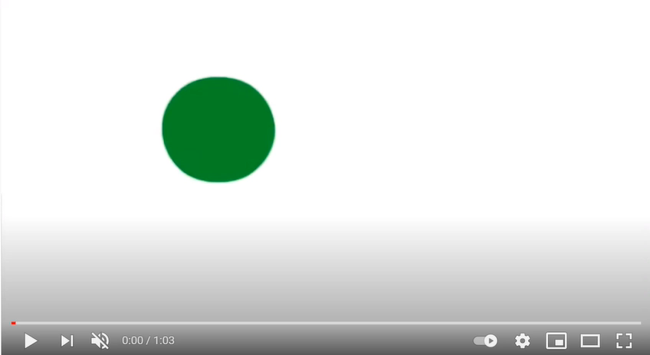
Saflo Insertion Technique

Slide 22
Documentation
Syringe driver documentation packs are available in the treatment room
Please ensure the correct documentation is used for in house or community use
What do you need to record?
Ensure you date, time and SIGN EVERYTHING you have documented
Remember If it wasn’t documented it didn’t happen

Slide 23
The Do’s & Do not’s
DO | DO NOT
Set-up a 2nd Syringe Driver if Total volume in syringe is >17mls More than 3 drugs are required Drugs are incompatible with each other | Exceed 17mls total volume in a syringe
Clearly label and document what drug is in which syringe, including total amounts | Mix the total volume of drugs across 2 syringes*
Ensure both syringe driver and paperwork match and are clearly labelled | Do not break the line to administer breakthrough medications
Do use a separate Saflo to administer breakthrough medications
Notes:
e.g If you have a reconstituted volume of 20 mls of drug A, 5mls of drug B and 2mls of drug C – syringe 1 could contain 17mls drug A and syringe 2 would contain 3mls of remaining drug A, 5mls drug B and 2 mls drug C made up to 17mls

Slide 24
Troubleshooting
Screen Information | Result/Cause | Possible Actions
Programme nearly complete | Programme is about to end/syringe is almost empty | Prepare to change syringe/discontinue pump use
Low Battery | Battery is almost depleted | Prepare to change the battery
Pump paused too long | Pump has been stopped/paused for more than 2mins without any key presses | Either press (play) key to resume infusion, press stop key to continue to pause for further 2mins/power off
Syringe Empty/removed | Current infusion programme has completed | Prepare to change syringe or discontinue pump use
End Battery | Battery will fail imminently | Change battery
Syringe displaced/check syringe | One/more of the syringe detection senses is not detecting | Check syringe and re-set as necessary. Check screen messages for assistance

Slide 25
Troubleshooting
Screen Information | Result/Cause | Possible Actions
Occlusion | Clamped set, occluded or kinked. Actuator has reached minimum travel position | Release the clamp, flush/ replace the access device or clear the occlusion
System Error | Alarm: an internal system error has occurred | If error recurs: take pump out of use. Press information key to obtain error message. Record error code and summary of fault and return pump to designated service centre
ERROR Start up MotMov fail, if problem persists send pump for service. | As Above | As Above

Slide 26
References
https://www.bd.com/en-uk/about-bd/video-gallery
https://youtu.be/MCGhmI98308
https://images.app.goo.gl/XpnTfmucvMJHyqf27
https://www.appm.org.uk/_webedit/uploaded-files/All%20Files/Event%20Resources/2020%20APPM%20Master%20Formulary%202020%20protected.pdf

