Slide 1


Documentation and Record Keeping

Slide 2
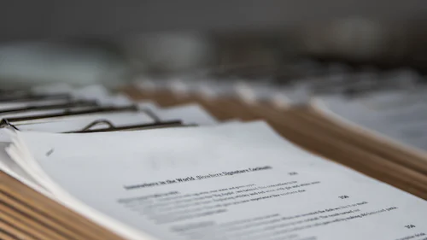
Nurses do not appreciate the importance of keeping records up to date until something goes wrong and their documentation is scrutinised. Often, in the event of a complaint or legal proceedings the only evidence the nurse will have to defend their actions is the medical notes and records. (Independent Nurse, 2016)

Slide 3

Objectives
By the end of this session learners will understand
Why is this important?
NMC Code
Consequences of poor documentation
Bad practice
Good practice (policy)
Evaluations notes
MAR charts
PEEPS
Delegation
Evaluation Notes Example

Slide 4
Why is documentation important?
It’s a LEGAL requirement
It’s part of our CQC inspection
It’s vital in ensuring patient care is not compromised
It protects YOU and DERIAN if an investigation/complaint takes place

Slide 5
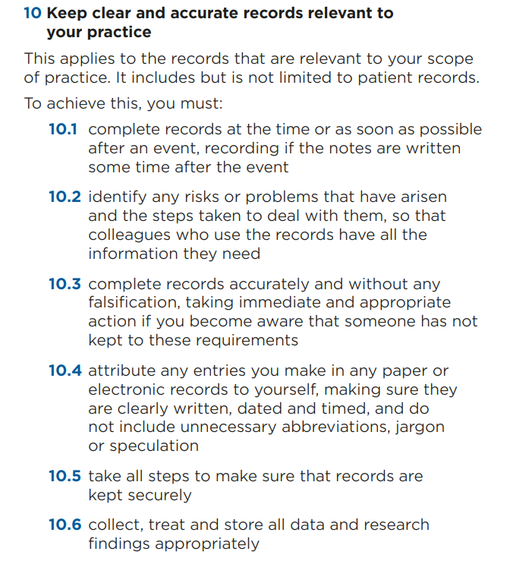

NMC Code
The Code (nmc.org.uk)

Slide 6
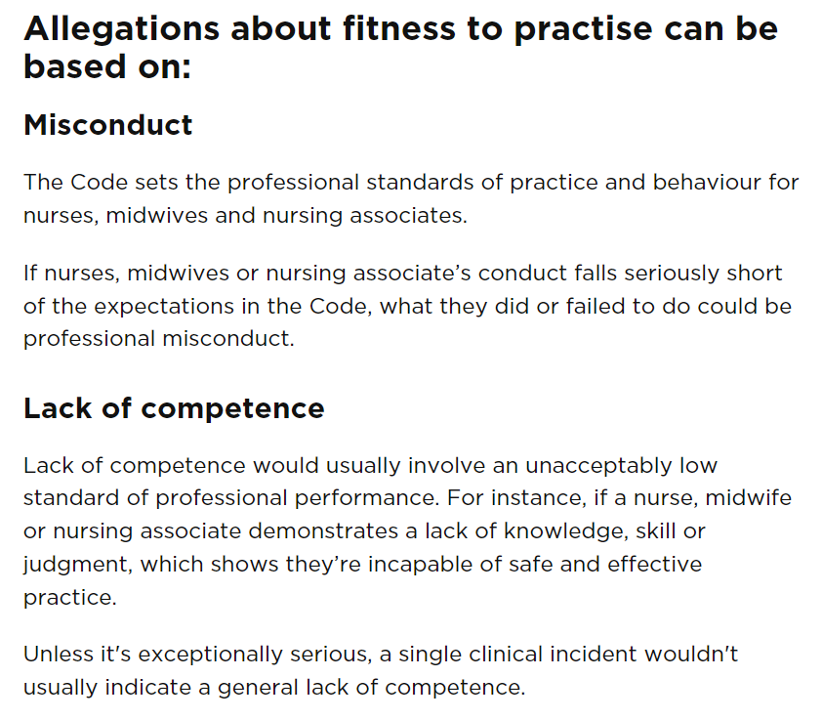

Consequences of poor Documentation
Poor Patient care, errors, incidents
Lack of supporting evidence to support investigation and lessons learned
Potential workplace disciplinary action/suspension or even dismissal
Referral to NMC Fitness to Practice panel
Lack of supporting evidence if a case is brought to civil, criminal or coroner’s court

Slide 7

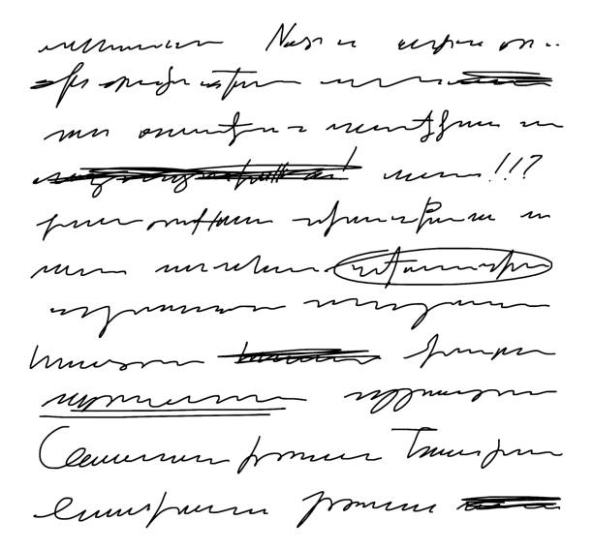
Examples of Unsafe Practice
Incomplete details on top of the pages
Writing in BLUE ink
Using Jargon/abbreviations without explanation*
Scribbling out entries
Destroying any records without being authorised to do so
*(Please be aware that as part of the medicines policy there have been some abbreviations that have been agreed at a local level that we can use within the hospice, see medications policy for further guidance)

Slide 8
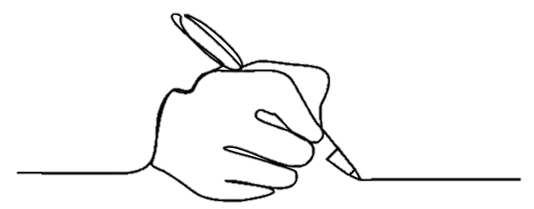
Safe Practice
Derian Policy – Standards of Clinical Record Keeping (2022) states….
Handwriting must always be legible.
USE CAPITALS IF YOUR HANDWRITING IS NOT EASILY READ (as in transcribing)
All writing must be made in black ink to ensure that it can be photocopied correctly
Records should be readable when photocopied or scanned
You must never falsify records.

Slide 9

Good Practice – Dates and Timings
Derian Policy- Standards of Clinical Record Keeping (2022) states….
Your records should be accurate and recorded in such a way that the meaning is clear
You must date and time admissions and discharges to Derian.
You must complete all records at the time or as soon as possible after an event, recording if the notes are written some time after the event

Slide 10

Good Practice – Signatories
Derian Policy- Standards of Clinical Record Keeping (2022) states….
All paper entries to records should be signed.
In the unlikely event that you need to alter your own or another healthcare professional’s records, you must give your name and job title, and sign and date the original documentation. You should make sure that the alterations you make, and the original record, are clear and auditable

Slide 11


Signatories Continued…
In the rare case of needing to alter a written record, the original entry must remain visible (draw a single line through the record) and the new entry must be signed, timed and dated.
Any correction must be striked through with one line (e.g. example) and signed and dated with your correction.

Slide 12

Information to be Recorded
You should use your professional judgement to decide what is relevant and what should be recorded
You should record details of any assessments and reviews undertaken, and provide clear evidence of the arrangements you have made for future and ongoing care. This should also include details of information given about care and treatment.
Records should identify any risks or problems that have arisen and show the action taken to deal with them
Ensure the next person to pick up those notes is able to have all the information they need to care for our Child or Young Person

Slide 13

Information to be Recorded Continued…
Where appropriate, the person in your care, or their carer, should be involved in the record keeping process
The language that you use should be easily understood by the people in your care
You must never use coded expressions of sarcasm or humorous abbreviations to describe the people in your care.
Please refer to the Derian Standards of Clinical Record Keeping 2022 for more information

Slide 14



Evaluation notes/Care plan
Handover what time you took over the cares from who
How did you find the child? E.g. settled, sleeping, upset.
Emergency equipment checked and working?
Who assisted you with all cares
Who checked medications and via what route they were administered
All interventions/interactions on the relevant charts
All omissions and reasons
All care plans should have a photo of the BCYP or state the reason the young person declined to have a photo
Bowels opened state type according to Bristol Stool Chart

Slide 15

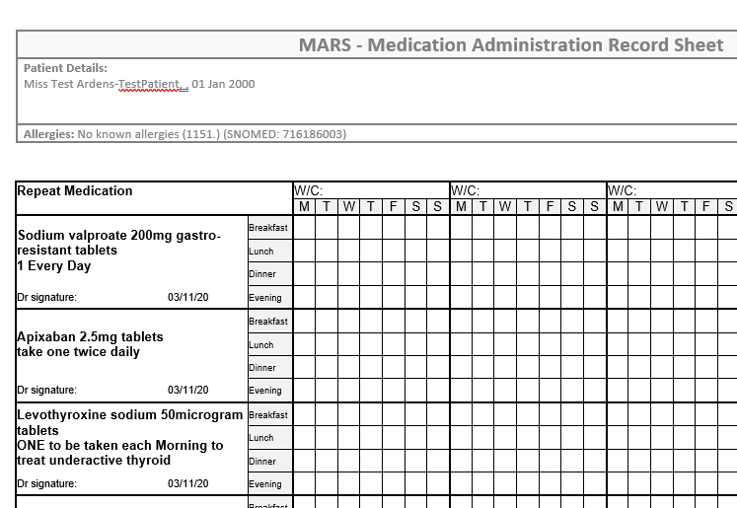
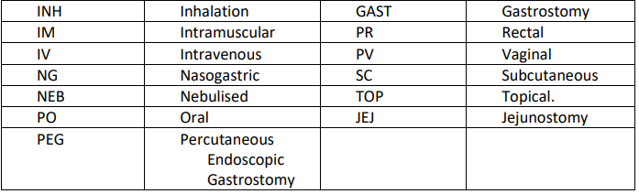
MAR Chart
All information completed on every page
Allergy and reaction completed in RED pen
GPs details
Weight on admission day
Drug name in capital letters if handwriting not clear
Use the Generic name instead of brand name (unless stated otherwise, for example if a particular brand of drug e.g. Epilim, is on the directives then please use this to avoid confusion)
Two signatures on all drugs during transcribing
Parent/guardian’s signature on all completed pages
Two signatures on all drugs when administering

Slide 16
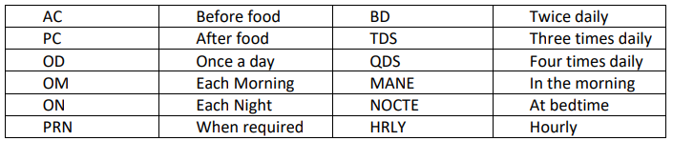
MAR Chart
Acceptable abbreviations on a MAR chart are as follows;

Slide 17


PEEP (Personal Emergency Evacuation Plan)
Completed/checked on admission with parents, and signed electronically sign by Parent and Nurse
To include physical/psychological issues, e.g.
How to evacuate/move? How many people needed?
What equipment do I need to take?
How will I react to the fire alarm?
Can I follow instructions/what will hinder my understanding?
Any other information to aid safe management in emergencies

Slide 18

Delegation of Tasks
Students must be assessed as competent before delegation.
If a student is working alongside a CSW then the nurse running the shift must countersign the students work.
All entries by nursing students to be checked and countersigned (name/signature/designation)
Only countersign witnessed activity or if you can validate it took place
Registered nurse retains professional accountability for appropriateness of delegating task, but student is personally responsible for content/quality of record
(ref: NMC’s Delegating Record-Keeping and Countersigning Records)

Slide 19
REMEMBER
Use the Handover sheet
Complete relevant charts for example… hydration charts
Sign Risk assessment
Date and time each entry (Check the correct time on care database)
Electronically sign off records by finishing entry
Corrections – line, sign and date if paper copy
Ensure that you are up to date in the use of electronic systems in your place of work, including security, confidentiality and appropriate usage

Slide 20


Documentation Audit
Audit results generally show good levels of compliance with quality measures for documentation at Derian House
The documentation Champion team are currently reviewing aspects of the documentation audit system to ensure that the data that we collect is meaningful in order to improve practice.

Slide 21
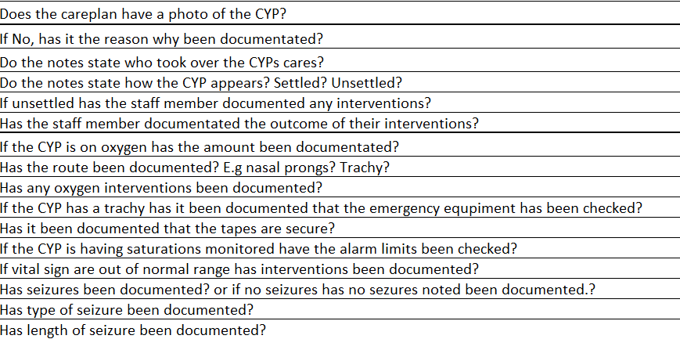
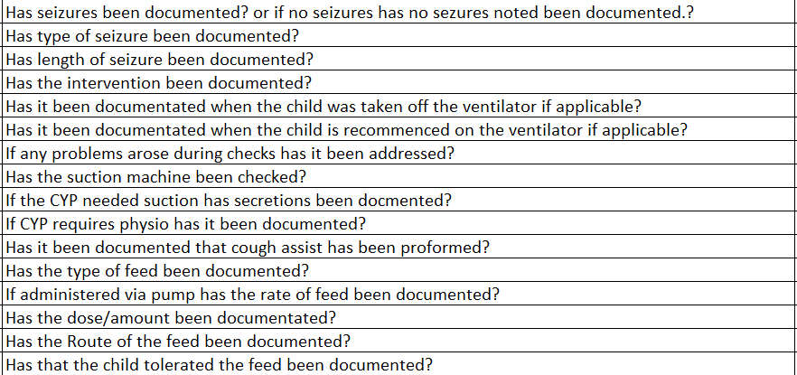

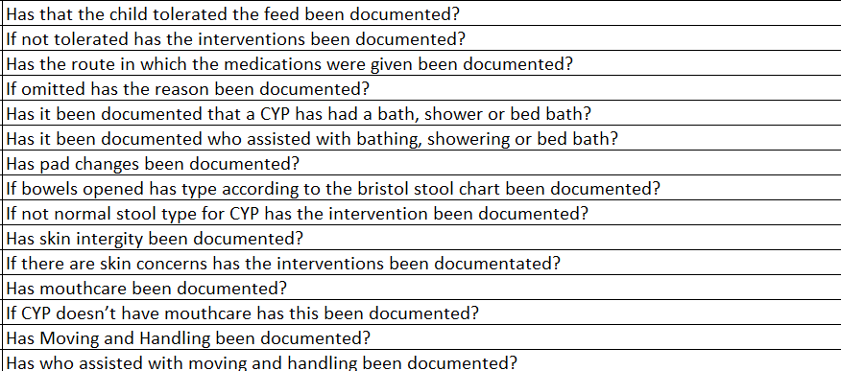
Documentation Audit
Here is the documentation audit which highlights all of the information (if applicable) which should be included in documentation for the cyp during your shift.
This includes audit considers documentation on the evaluation of care and any other charts such as seizure/ hydration charts.
Please familiarize yourself with this

Slide 22

Evaluation Notes Example
10/07/2023
All cares taken over by myself nurse Joe Blogs at 0740, from clinical support worker (CSW) John Smith.
(Childs name) nursed in 0.5 litres oxygen via tracheostomy, ventilator checks completed and checked against directive with nurse Alice Brown.
Emergency equipment checked, working and correct. Tracheostomy tapes checked and secure. (Child name) currently on saturation monitoring vital signs stable heart rate 86bpm and saturations 99%, child (name) settled.
Bed bath provided with assistance from nurse Alice Brown, pad changed urine passed and bowels opened type 6 stool this is a normal stool type according to care plan. Sudocrem applied to groin area as slightly red, skin intact and no other skin concerns. Teeth brushed and oral suction provided clear secretions obtained.
Hoisted (child's name) from bed into wheelchair with assistance form Alice Brown, medications checked with Alice brown and administered as per MAR Chart via gastrostomy. 50ml H20 flush administered pre and post medications and feed commenced, Peptamen Junior 250ml @250ml/hr. No concerns
Tracheostomy suction provided due to audible secretions size 10 catheter down to 8 cm, clear secretions obtained child settled and stable.
Hoisted from chair into bed with assistance from Alice Brown, changed into pyjamas, teeth brushed oral suction provided clear secretions obtained, pad changed urine passed no skin concerns.
All cares handed over to CSW Laura Taylor at 2030, (childs name) settled and asleep. No concerns
20:35
Joe Bloggs
J.Bloggs
Staff Nurse (RNC)

Slide 23


NMC Court Hearings
‘That you, a Registered Nurse on 26 August 2018 after witnessing Patient A fall to their knees:
1) Failed to complete an accident form.
2) Failed to complete a falls risk assessment.
3) Failed to refer to outside medical advice.
4) Failed to refer to the falls team.
5) Failed to complete 4 hourly observations of Patient A.
6) Failed to record any observations of Patient A.
7) Failed to ensure observations were undertaken for at least 24 hours.

Slide 24

NMC Court Hearings
‘That you, a registered nurse:-
1. Between 23 December 2020 and 27 April 2021 failed to ensure that patient records and/or risk assessments were completed to an adequate standard on one or more occasions
2. On 6 January 2021 a progress note record contained very limited information and did not follow the template routinely used
3. On 23 February 2021 copied significant parts of a previous entry on a core assessment document which did not accurately reflect your contact with the patient

Slide 25

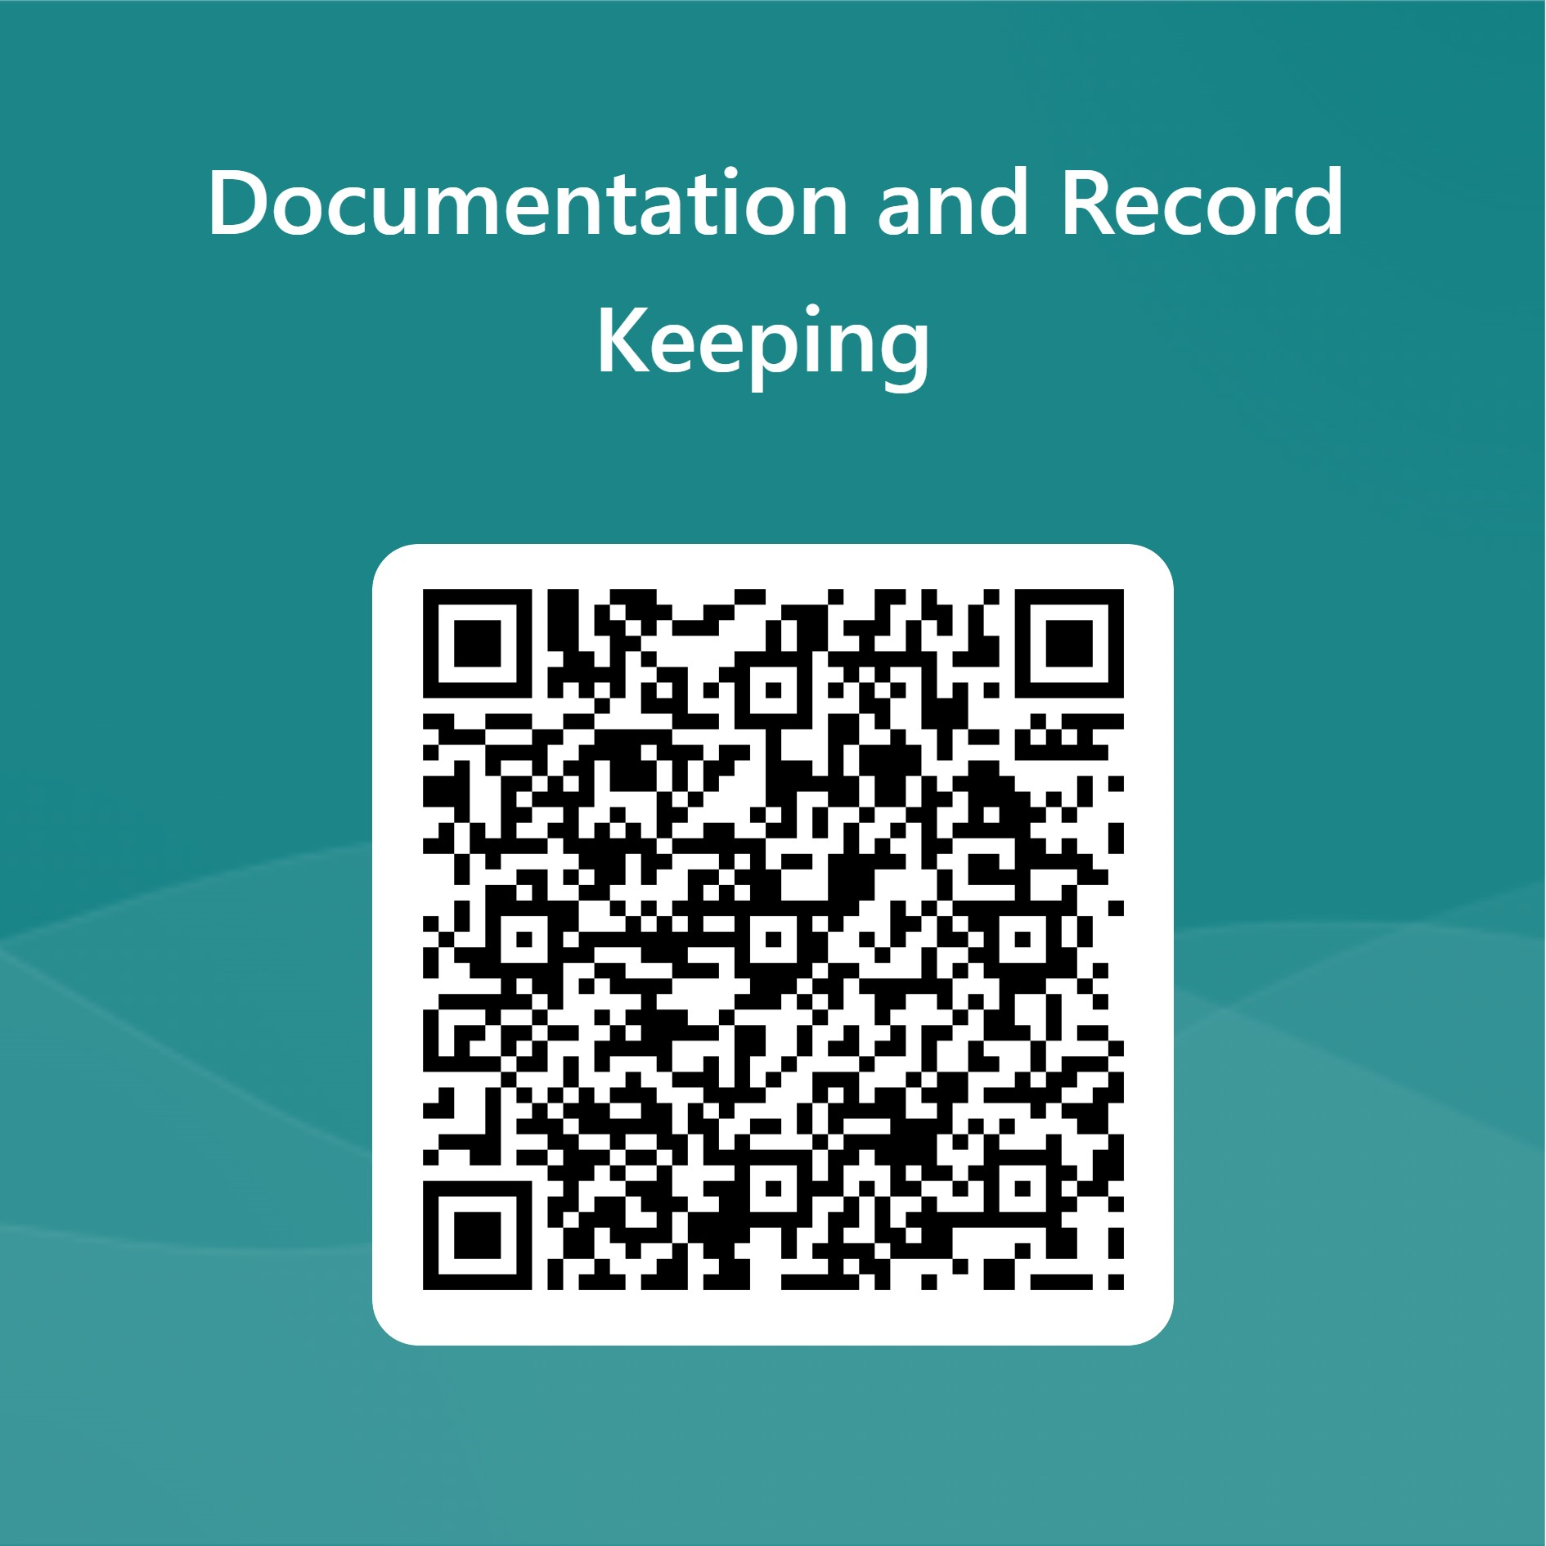
Any Questions?
(Please email Alicia Wiley, Lisa Morgan,
Rhianne & Natalie Lewis )
Please click the following link when you have completed the learning in order to record that you have completed it
https://forms.office.com/e/01F9iWw12R
You will need to view the PowerPoint in full screen for it to work, any issues just email clinical.education@derianhouseco.uk with the date that you completed it

