Slide 1

Tissue Viability

Slide 2

Learning objectives
To understand more about tissue viability, the skin and pressure ulcers
To be able to recognise and score pressure ulcers using the Pressure ulcer categories
To understand how pressure ulcers are caused and the different risk factors that can contribute
To identify the actions that we can do to prevent pressure ulcers from occurring
To understand and implement the Purpose T tool into tissue viability assessments and care plans

Slide 3
What is tissue viability?
The actions taken to maintain and manage skin integrity.
Involves the management of acute and chronic wounds and the prevention and management of pressure damage.
In the UK, each year, approximately 700,000 people are reported to have a pressure sore.
It is estimated that 80% of these would have been avoidable with the use of preventative measures.

Slide 4
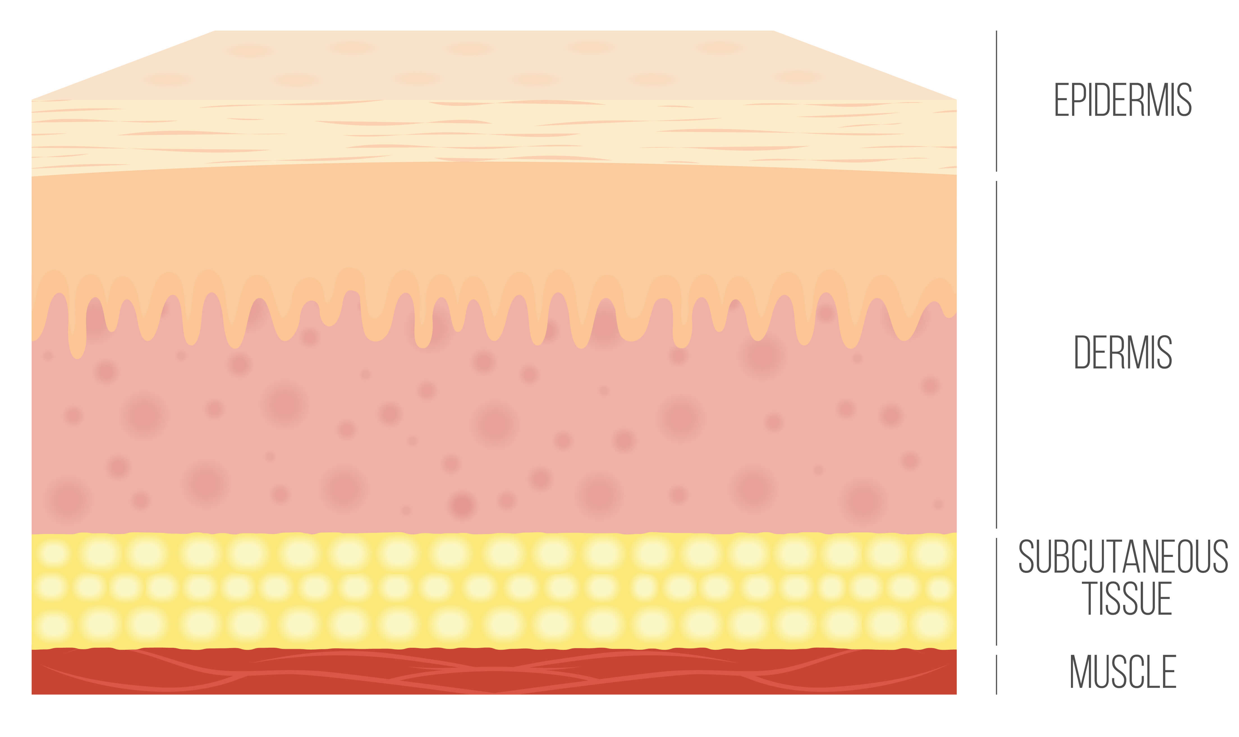
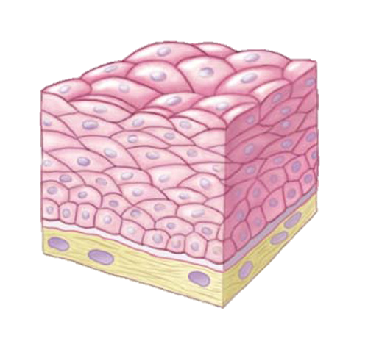
The Skin
Largest organ in the body.
Has 3 layers,
Epidermis, dermis, subcutaneous tissue (hypodermis)
Has 3 functions,
Protection from microbes, mechanical and environmental factors.
Regulates body temperature, changes in peripheral circulation and fluid balance.
Sensation – to detect changes in heat, cold, touch and pain.

Slide 5
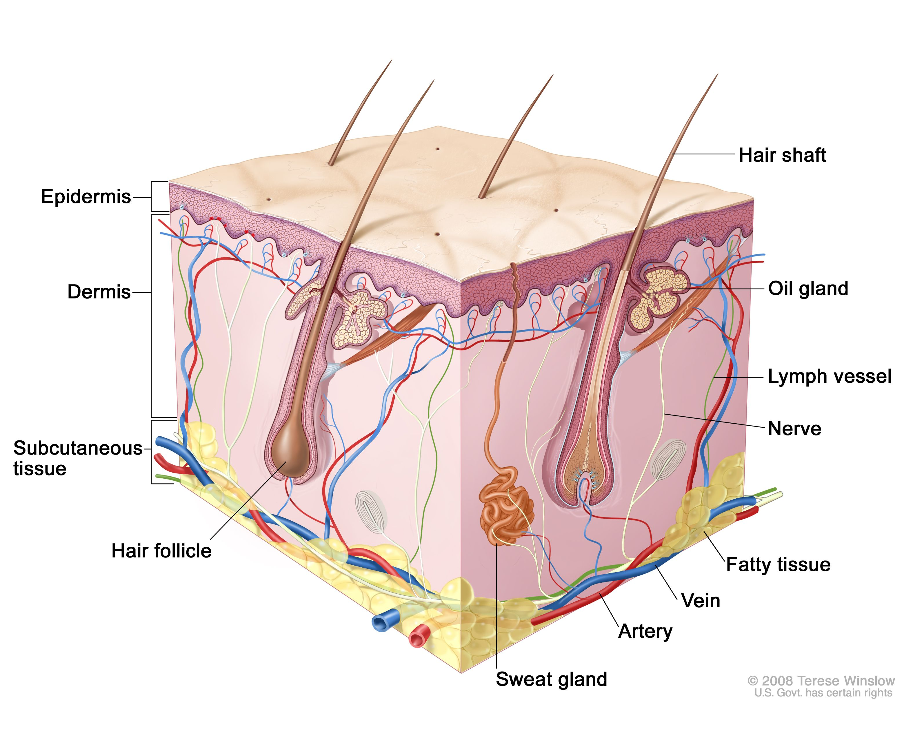
Epidermis
Thin outer layer which provides a waterproof barrier and creates skin tone.
Approximately 0.04mm thick
It doesn’t have its own layer of blood vessels and gets its nutrients from the dermis.
It renews itself every 4 weeks.
Dermis
Approximately 0.5mm thick
Connective tissue
Blood vessels
Nerves
Hair follicles
Oil and sweat glands
Lymph vessels
Layers of the skin
Subcutaneous Tissue
Made up of,
  Fat
  Blood vessels
  Connective tissues
Forms a protective layer over underlying organs and structures.
Acts as an energy source for the body.
Provides insulation from changes in the outside temperature.

Slide 6
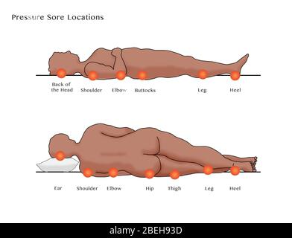
What is a pressure ulcer?
A pressure ulcer is defined as localized damage to the skin and/or underlying tissue, as a result of pressure or pressure in combination with shear. They usually occur over a bony prominence but may also be related to a medical device or other objects.
Pressure ulcers most commonly occur over bony prominences but can develop on any part of the body, including mucosal surfaces.
(EPUAP/NPIAP/PPPIA, 2019; NHS England, 2019; OHID, 2022)

Slide 7
Early signs of a Pressure Ulcer
Skin becoming discoloured – pale skin will show red patches, darker skin will show purple or blue patches.
Discoloured patches not turning white when pressed.
An area of skin feeling warmer or colder than the skin around it.
An area of skin feeling spongy or hard.
Pain or itchiness.
These would indicate a category 1 pressure ulcer.

Slide 8
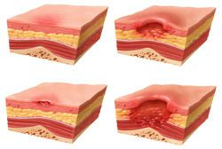

Pressure Ulcer Categories
Category 1 – discoloured patches, surface damage
Deep tissue damage – the skin is intact, but the area beneath is injured
Category 2 – open wound or blister
Unstageable – full thickness skin or tissue loss
Category 3 – a wound that reaches the deep layers of the skin
Click the link on the apple below to open the SKIN apple poster guide for pressure ulcer grading with images
Category 4 – a wound that reaches the muscle and bone

Slide 9
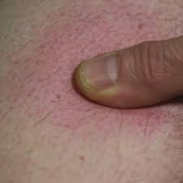
Blanch Test
The first sign of skin damage is often a red mark on white skin and a purple or blue mark on darker skin tones.
A blanch test involves pressing a finger lightly on the affected area, holding for 5 seconds then lifting the finger away.
If the skin goes pale (blanched) and then returns to its original colour, this is not currently pressure damage.
If the skin does not change colour (non – blanchable), this is a category 1 pressure ulcer.
Please remember that in darker skin tones, the blanch test has limited value.

Slide 10
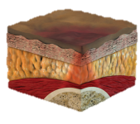



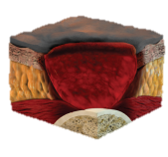
Darker skin tones
Signs of pressure damage;
  Feeling warmer or cooler than the surrounding skin
  Pain
  Purple colour of the skin
  Soft boggy areas
  Firmness
Click on the hand for a useful tool to help stage pressure ulcers in darker skin (with images)

Slide 11
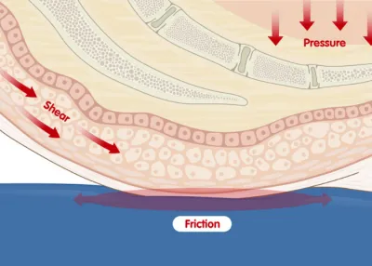
How are Pressure Ulcers caused?
Direct pressure
Pressure + friction or shear

Slide 12
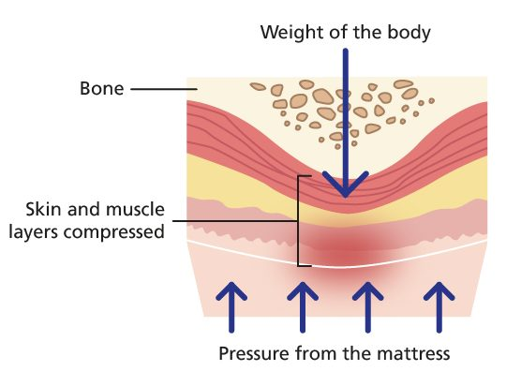
Pressure
A bony area presses down through the tissue layers against the hard surface, this pinches the blood vessels and restricts blood flow, oxygen and nutrients to the area.
If the pressure is not relieved regularly the tissues start to break down causing a pressure ulcer to develop.

Slide 13
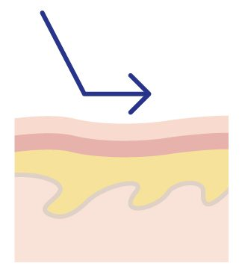
Shear
Pressure that occurs when layers of skin are forced to slide over one another or over deeper tissues.
Causes the internal tissues to stretch and tear causing damage.
For example, someone slouching or slipping down the bed, or being pulled up out of the bed or a chair.

Slide 14
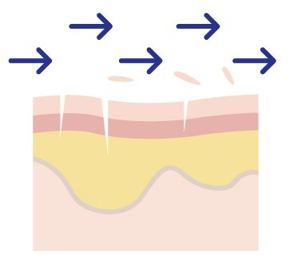
Friction
Caused by something rubbing against the skin such as a mattress or clothing.
This causes skin stripping where the top layers of the skin are damaged.
Skin damage due to friction alone leads to superficial abrasions and a vulnerability to pressure ulcers.

Slide 15
Risk factors
Is their movement restricted?
Can they change position themselves?
Do they spend a lot of time in bed or in their chair?
Do they have a medical device?
Are they incontinent?
Do they sweat a lot?
Have they had previous skin damage?
Are they unable to communicate?
Are they unable to feel parts of their body?
Prolonged pressure
Damaged/weakened skin
Communication and sensation

Slide 16
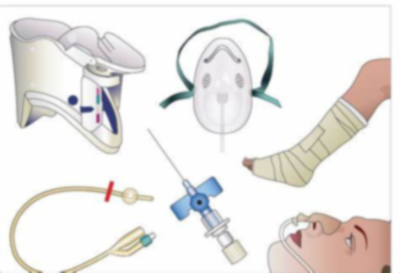
Medical equipment
Other areas at risk of developing a pressure ulcer are those that have a medical device attached including,
  Ears, nose and cheeks – nasogastric/nasojejunal tube, nasal cannula
  The face – oxygen or non – invasive masks
  Arms and legs – plaster casts, splints, hip spica’s
  Body – tracheostomy, feeding tubes, monitoring probes, braces
Managing devices
Reposition equipment/tubing when able
Ensure the CYP isn’t sitting/lying on any tubing

Slide 17
How to Prevent Pressure Ulcers
Keep moving
Prolonged pressure over bony and vulnerable areas can cause a pressure ulcer to develop.
Frequent position changes will relieve pressure and return blood flow.
CYP should be repositioned every 2 to 4 hours to relieve pressure areas if they are unable to change their own position.
Incontinence and moisture
When the skin is exposed to moisture for a significant period, this can cause damage to the skin.
The most common cause of moisture damage is incontinence.
Other sources of moisture damage include; sweat, fluid leaking from a wound, saliva and mucus or fluid from the nose, gastrostomy site, tracheostomy site.
Nutrition/hydration
Vitamins are essential for wound healing and to maintain healthy skin.
Adequate fluid intake is necessary to prevent the skin becoming dry and brittle.
Unplanned weight loss can lead to loose weakened skin.
Being overweight has the potential to lead to higher levels of sweat, an increase in moisture damage and the risk of skin damage.

Slide 18
Assking Framework
A
N
G
Give information- use the most appropriate method of communication to increase awareness of BCYPs risk and promote pressure ulcer prevention
I
S
S
K
Assess Risk- screening every BCYP on every admission, completing section 1 of the Purpose T Tool
Skin Assessment – conduct a full skin assessment within 6 hours of admission and consider all risk factors. Document the presence of vulnerable skin and pain
Surface- consider the bed, chairs, mattress, orthotic devices, medical devices
Keep Moving- Consider the level of mobility and availability of moving and handling equipment
Incontinence/ increased moisture- Identify the risk of moisture related skin damage
Nutrition- consider the impact of inadequate nutritional need and absorption

Slide 19
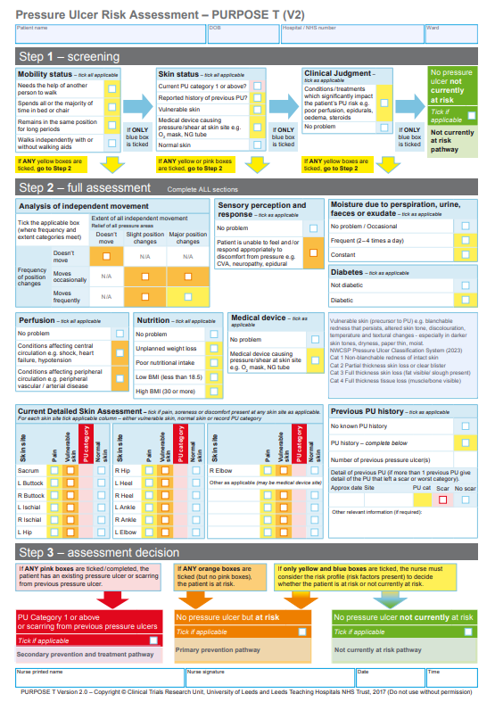
Purpose T Tool
From September 2024, we will be switching from Braden Q to Purpose T for our Skin Assessments
These risk assessments need to be completed by nurses within 6 hours of admission (or as close as possible) and on every admission and again if there are any changes to condition or skin that affects their risk.
Nurses need to curate a care plan on care database for those identified as at risk of pressure ulcers and skin damage- this is a primary prevention pathway.
CSW’s should review the Purpose T risk assessment and follow the care plan, informing a nurse of any changes or concerns

Slide 20
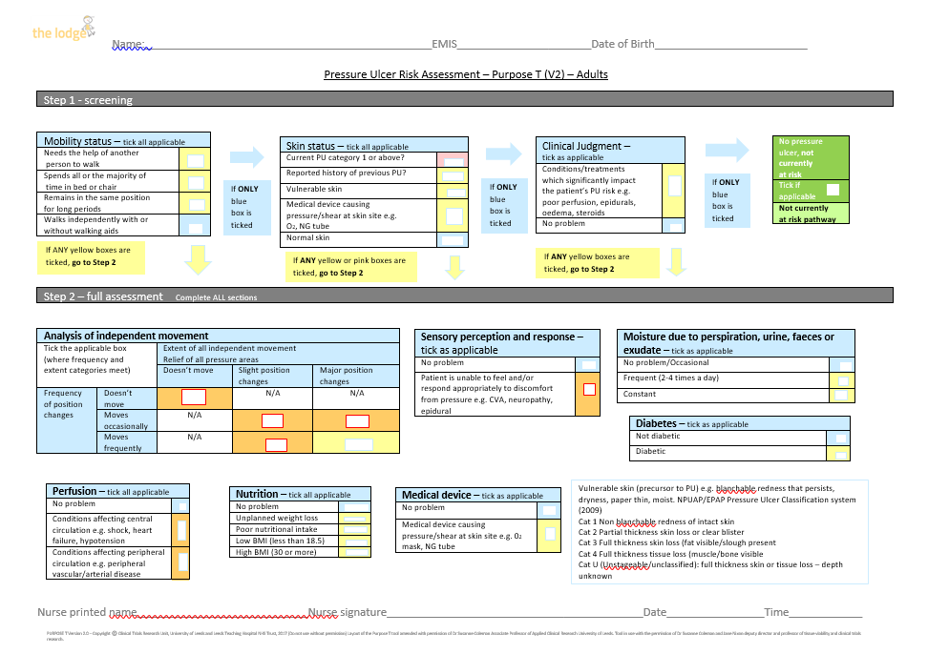
Purpose T Tool- Adult

Slide 21
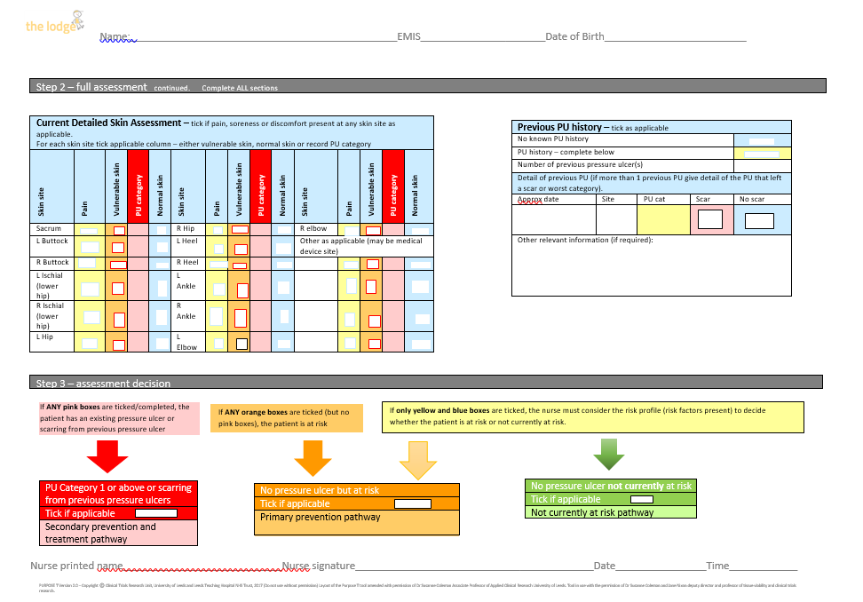
Purpose T Tool- Adult

Slide 22
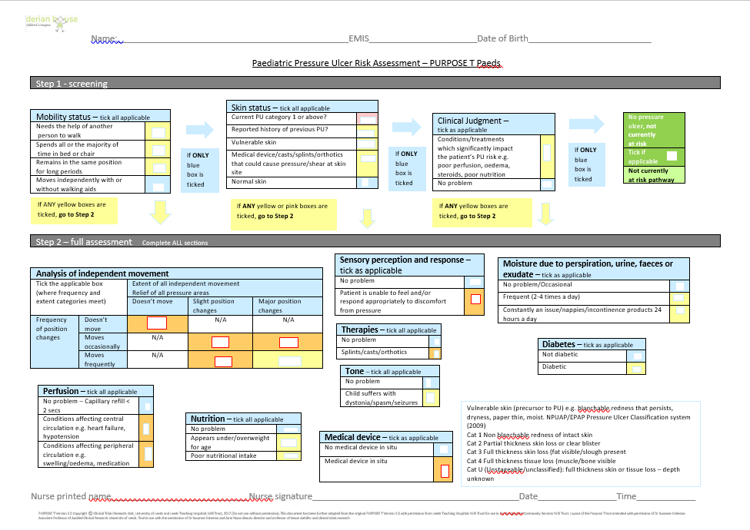
Purpose T Tool- Paediatric

Slide 23
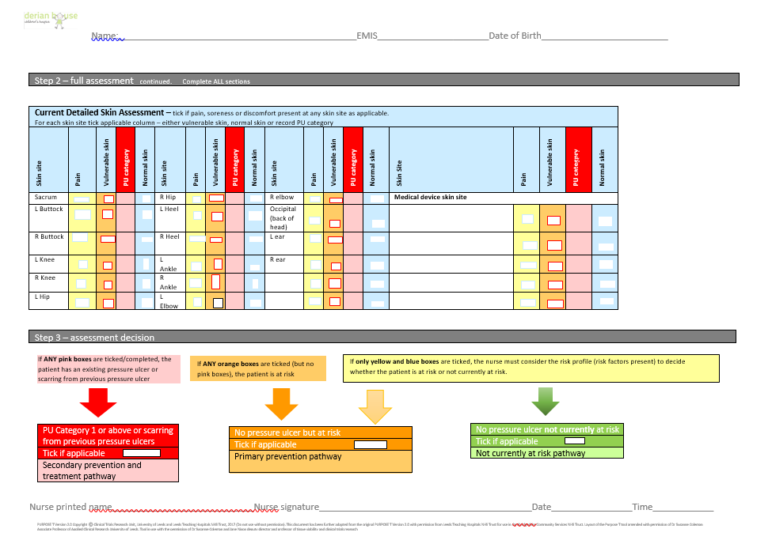
Purpose T Tool- Peadiatric

Slide 24

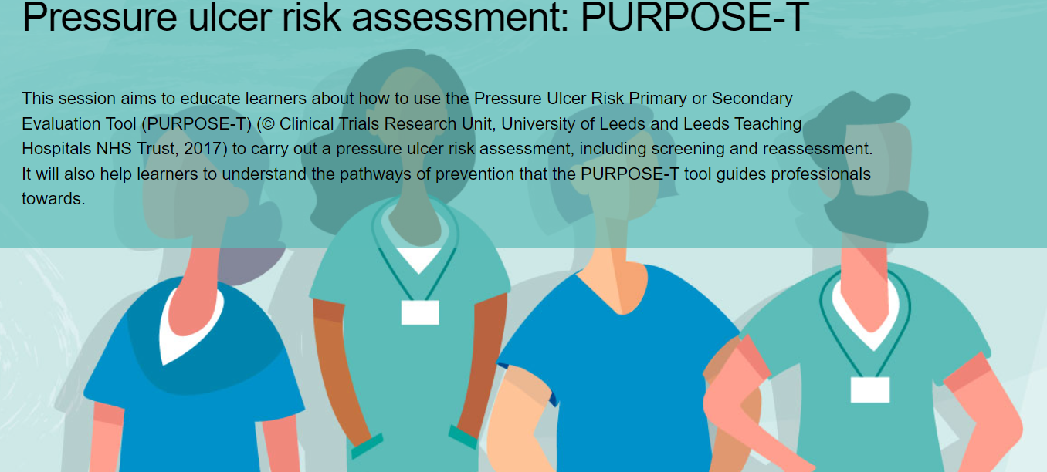
Purpose T Tool Elearning
There is Purpose T Tool Elearning training to complete as a one off for all Nurses, NA’s AP’s and CSW’s. Login to Elearning for health using your usual login
1. Search ‘wound care’
2. Click on this category and enrol, then click Tier 1 Essentials
3. Complete this course
4. Send completed certificates to clinical.education@derianhouse.co.uk

Slide 25
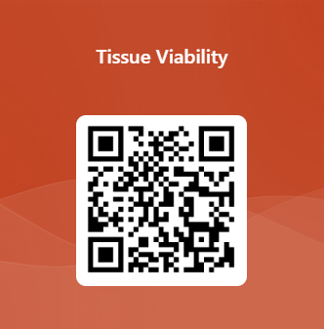
Use the link or QR code below to register that you have read and understood this presentation. Links will only work when the presentation is viewed in full screen
https://forms.office.com/e/kWCzyjpQQz

Slide 26
References
https://library.sheffieldchildrens.nhs.uk/preventing-pressure-ulcers/
https://www.gov.uk/government/publications/pressure-ulcers-applying-all-our-health/pressure-ulcers-applying-all-our-health
https://www.dermatoljournal.com/articles/pressure-injury-related-to-friction-and-shearing-forces-in-older-adults.html
https://www.hse.gov.uk/skin/professional/causes/structure.htm
NWCSP-PU-Clinical-Recommendations-and-pathway-final-24.10.23.pdf (nationalwoundcarestrategy.net)

